Slide 1
What is a topology
A network topology is the physical and logical arrangement of nodes and connections in a network. Nodes usually include devices such as switches (A network switch is networking hardware that connects devices on a computer network by using packet switching to receive and forward data to the destination device), routers (A router is a device that connects two or more packet-switched networks or subnetworks. It serves two primary functions: managing traffic between these networks by forwarding data packets to their intended IP addresses, and allowing multiple devices to use the same Internet connection.) and software with switch and router features. Network topologies are often represented as a graph.

Slide 2
Contd….
Network topology defines the layout, virtual shape, or structure of the network, not only physically but also logically. A network can have one physical topology and multiple logical topologies at the same time.
In a computer network, there are mainly six types of physical topology, they are:

Slide 3
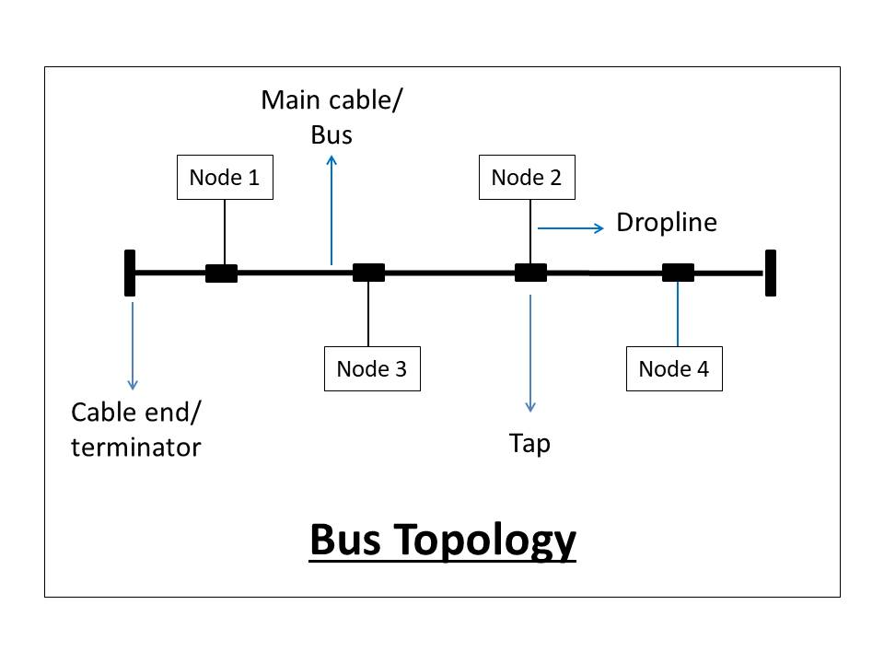
Bus Topology
Bus topology is the simplest kind of topology in which a common bus or channel is used for communication in the network. The bus is connected to various taps and droplines. Taps are the connectors, while droplines are the cables connecting the bus with the computer. In other words, there is only a single transmission line for all nodes.

Slide 4
Advantages
Simple to use and install.
If a node fails, it will not affect other nodes.
Less cabling is required.
Cost-efficient to implement.

Slide 5
Disadvantages
Efficiency is less when nodes are more(strength of signal decreases).
If the bus fails, the network will fail.
A limited number of nodes can connect to the bus due to limited bus length.
Security issues and risks are more as messages are broadcasted to all nodes.
Congestion and traffic on the bus as it is the only source of communication.

Slide 6
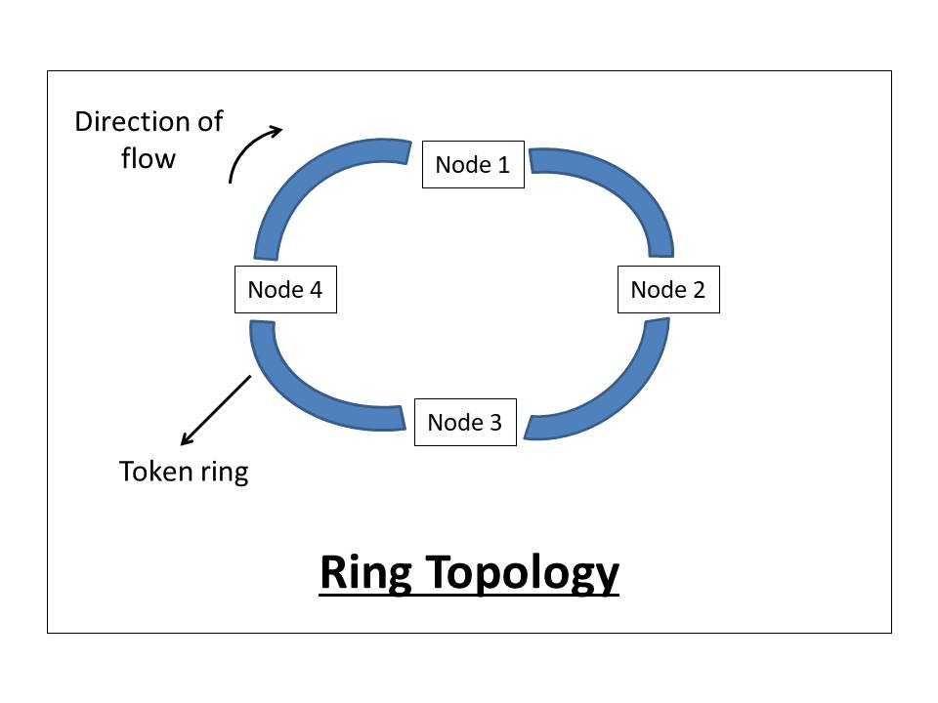
Ring Topology
Ring topology is a topology in which each computer is connected to exactly two other computers to form the ring. The message passing is unidirectional and circular in nature.
This network topology is deterministic in nature, i.e., each computer is given access for transmission at a fixed time interval. All the nodes are connected in a closed-loop. This topology mainly works on a token-based system and the token travels in a loop in one specific direction.

Slide 7
Advantages
Easy Installation.
Less Cabling Required.
Reduces chances of data collision(unidirectional).
Easy to troubleshoot(the faulty node does not pass the token).
Each node gets the same access time.

Slide 8
Disadvantages
f a node fails, the whole network will fail.
Slow data transmission speed(each message has to go through the ring path).
Difficult to reconfigure(we have to break the ring).

Slide 9
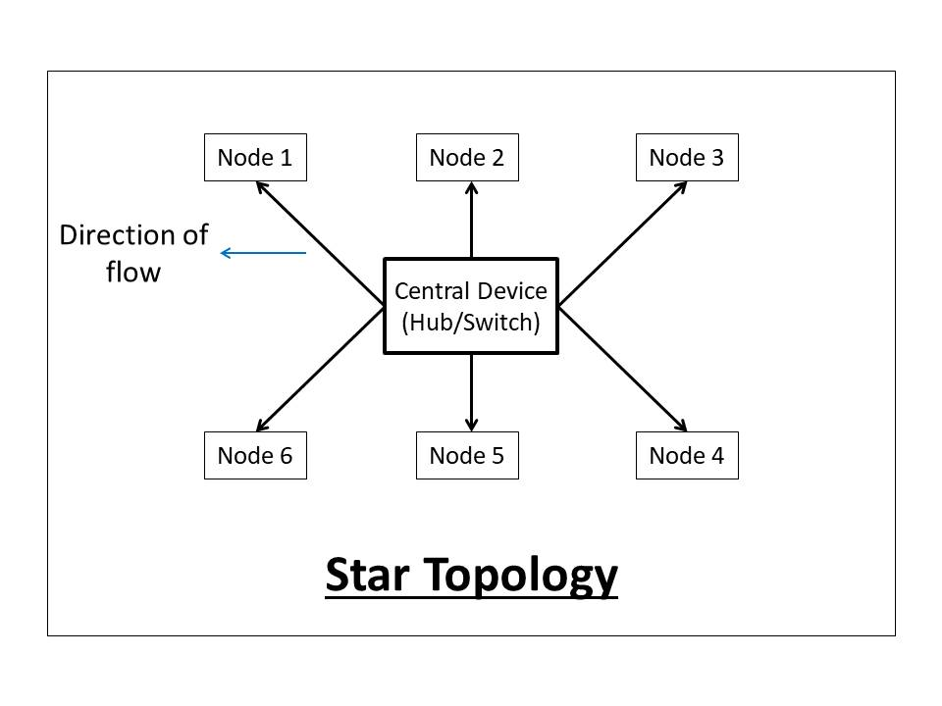
Star Topology
Star topology is a computer network topology in which all the nodes are connected to a centralized hub. The hub or switch acts as a middleware between the nodes. Any node requesting for service or providing service, first contact the hub for communication.

Slide 10
The central device(hub or switch) has point to point communication link(the dedicated link between the devices which can not be accessed by some other computer) with the devices. The central device then broadcast or unicast the message based on the central device used. The hub broadcasts the message, while the switch unicasts the messages by maintaining a switch table. Broadcasting increases unnecessary data traffic in the network.
In a star topology, hub and switch act as a server, and the other connected devices act as clients. Only one input-output port and one cable are required to connect a node to the central device. This topology is better in terms of security because the data does not pass through every node.

Slide 11
Advantages
Centralized control.
Less Expensive.
Easy to troubleshoot(the faulty node does not give response).
Good fault tolerance due to centralized control on nodes.
Easy to scale(nodes can be added or removed to the network easily).
If a node fails, it will not affect other nodes.
Easy to reconfigure and upgrade(configured using a central device).

Slide 12
Disadvantages
If the central device fails, the network will fail.
The number of devices in the network is limited(due to limited input-output port in a central device).

Slide 13
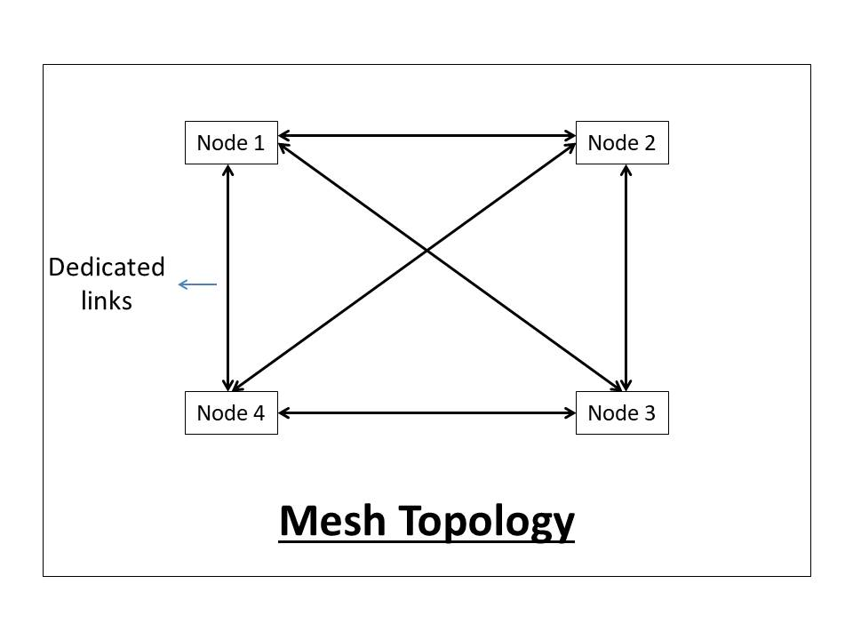
Mesh Topology
Mesh topology is a computer network topology in which nodes are interconnected with each other. In other words, direct communication takes place between the nodes in the network.

Slide 14
There are mainly two types of Mesh:
Full Mesh: In which each node is connected to every other node in the network.
Partial Mesh: In which, some nodes are not connected to every node in the network.

Slide 15
Advantages
Dedicated links facilitate direct communication.
No congestion or traffic problems on the channels.
Good Fault tolerance due to the dedicated path for each node.
Very fast communication.
Maintains privacy and security due to a separate channel for communication.
If a node fails, other alternatives are present in the network.

Slide 16
Disadvantages
Very high cabling required.
Cost inefficient to implement.
Complex to implement and takes large space to install the network.
Installation and maintenance are very difficult.

Slide 17
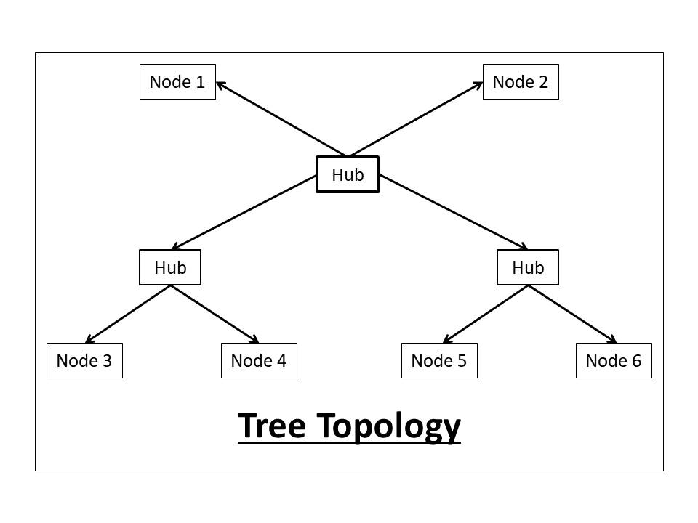
Tree Topology:
Tree Topology:
Tree topology is a computer network topology in which all the nodes are directly or indirectly connected to the main bus cable. Tree topology is a combination of Bus and Star topology.

Slide 18
Advantages
Large distance network coverage.
Fault finding is easy by checking each hierarchy.
Least or no data loss.
A Large number of nodes can be connected directly or indirectly.
Other hierarchical networks are not affected if one of them fails.

Slide 19
Disadvantages
Cabling and hardware cost is high.
Complex to implement.
Hub cabling is also required.
A large network using tree topology is hard to manage.
It requires very high maintenance.
If the main bus fails, the network will fail.

Slide 20
Hybrid Topology:
A Hybrid topology is a computer topology which is a combination of two or more topologies. In practical use, they are the most widely used.
In this topology, all topologies are interconnected according to the needs to form a hybrid. All the good features of each topology can be used to make an efficient hybrid topology.

Slide 21
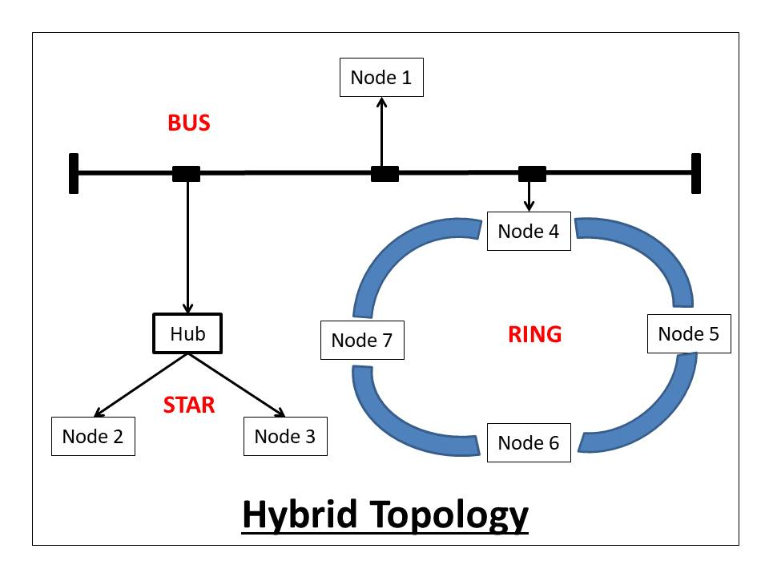

Slide 22
Advantages
It can handle a large volume of nodes.
It provides flexibility to modify the network according to our needs.
Very Reliable(if one node fails it will not affect the whole network).

Slide 23
Disadvantages
Complex design.
Expensive to implement.
Multi-Station Access Unit(MSAL) required.

